Slide 1
Conferencing & Collaboration Cisco WebEx T29 Upgrade August/September 2015

Slide 2
Agenda
In-Meeting Enhancements
Personal Room (available upon request for direct net sites)
Site Admin Updates
Q&A

Slide 3
Cisco WebEx T29 Upgrade Support
Please contact Verizon Net Technical Support for Assistance
nettech@verizon.com OR 1-800-475-5000 option 2, option 2

Slide 4
In-Meeting Enhancements
Cisco WebEx T29 Upgrade

Slide 5
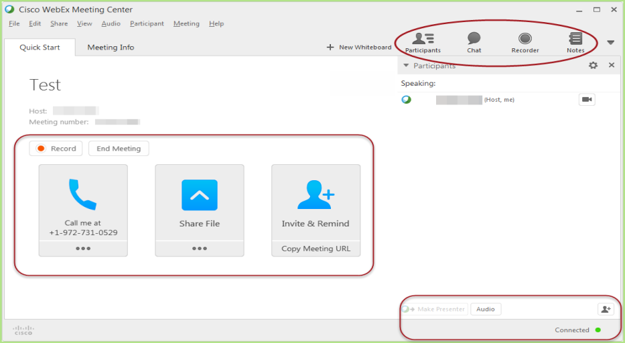
Modern, simplified meeting experience (Meeting and Event Center—Windows)
New modern design and clean layout
New icons, fonts, and colors
Consolidated controls in Quick Start page
Improved icons for panels
Intuitive Audio dialog box
Improved Sharing dialog box
Improved Invite & Remind dialog box
Attendee can view screen sharing and application sharing within a tab of the meeting
Minimize transitions for attendee while providing easy access to video and meeting controls
Content sharing and video size is adjustable by simply dragging the mouse
Easy to access Annotation tools and other functions
Vertical Annotation bar with updated icons (Windows only)
Easily access View options to control viewing preference
New and updated Annotation Tool icons
Improved dialogs
Improved notifications
New icons in meeting control panel for the Presenter

Slide 6
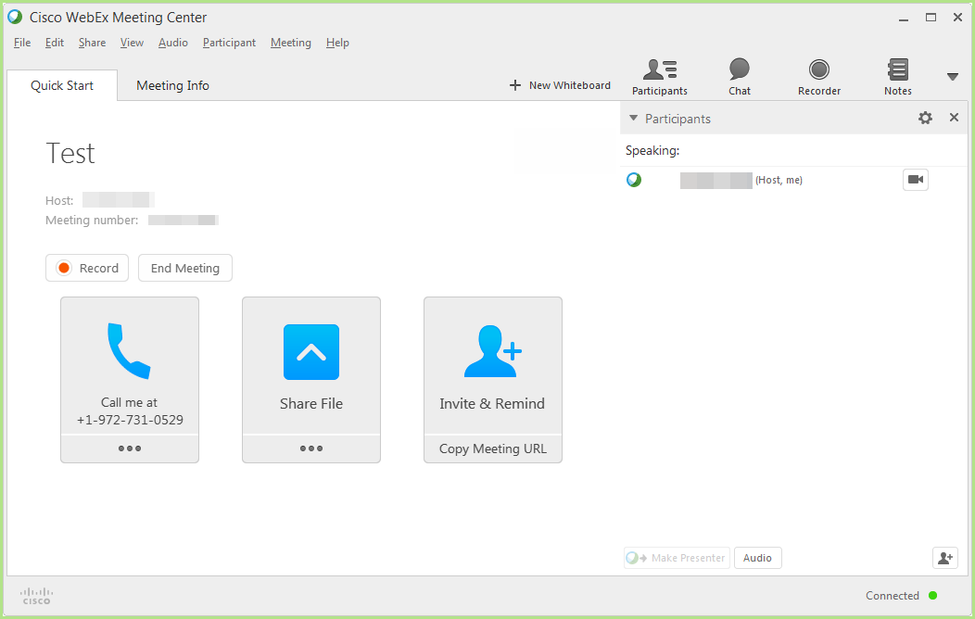
Meeting experience usability enhancements
The presenter role automatically passes to the host when the host joins, even if the first attendee has become a presenter. The only exception is if an attendee is sharing content. (Meeting Center)
Allows presenter role to automatically pass to the person who has control of the meeting
The screen saver is disabled during content sharing (all Centers)
Allows users to focus on the content without interruption
Sites will automatically have Chat and Notes panels minimized, with these panels showing icons at top that users can select to open (Meeting Center & Event Center)

Slide 7
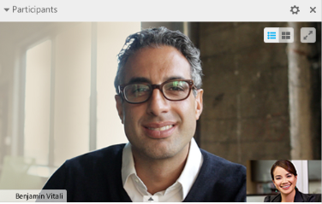
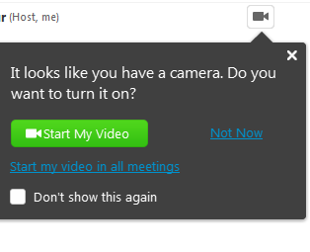
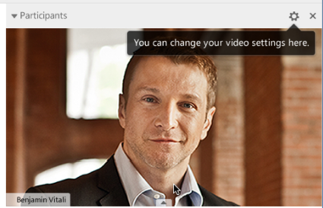
Improved video experience (Meeting and Event Center—Windows)
New video control layout options at the top of video display on Participant List
When one user sends video, the default meeting window view changes to 50% video view (unless sharing is going on)
When 2 or more people send video, the video panel automatically changes to video thumbnail view
If a camera is detected, the user will see a message to send Video (Meeting Center only)
Users can also specify to send video by default in all meetings (can be changed in video settings)

Slide 8
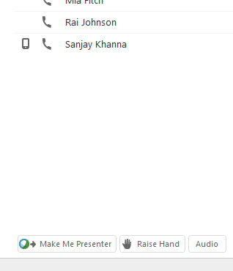
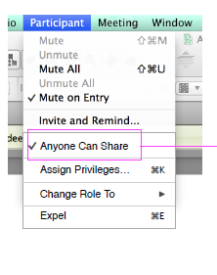
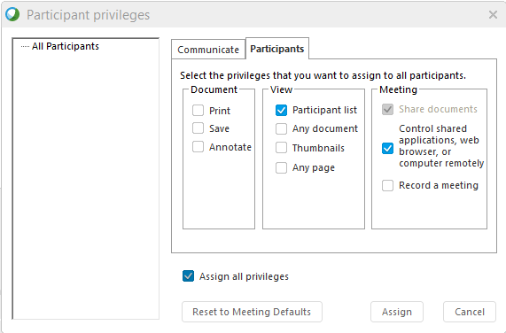
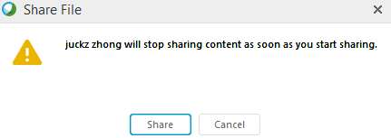
Anyone Can Share (Meeting Center)
Enabled by default & can be turned off in Site Admin
If enabled, allows participants to start sharing content immediately without being made presenter first. This option is enabled by default for new sites.
The host can disable the option during the meeting.

Slide 9
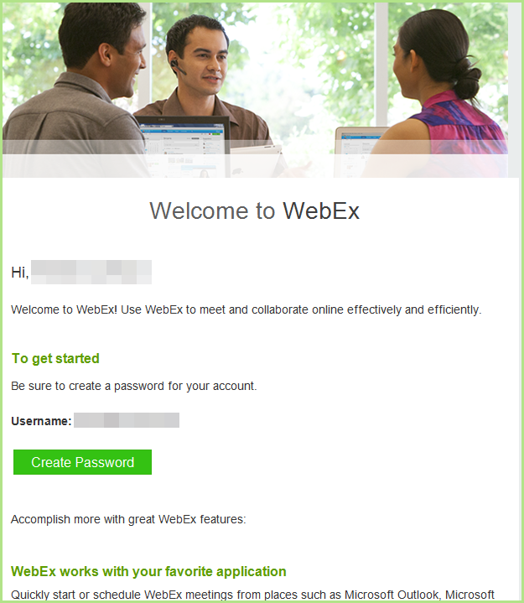
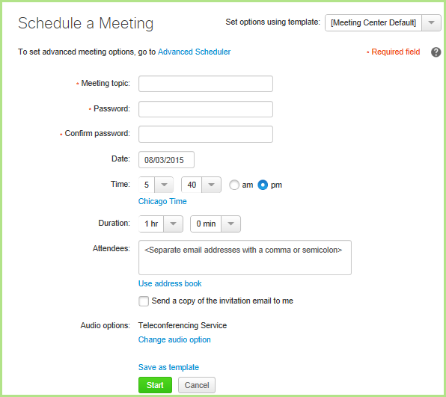
WebEx page redesign and accessibility updates
Improved accessibility and simplified user experience
Meeting Scheduler Updates
“Welcome” page renamed to “Home”
One-Click meeting changes:
"One-Click" command renamed to “Meet Now”
Starts a meeting in your Personal Room by default
Message to let the user know that “Meet Now” starts a meeting in your Personal Room
Users can change back to the old dynamic link in Preference
Introducing HTML email templates for Meeting Center
Join meeting experience
A faster and cleaner join experience

Slide 10
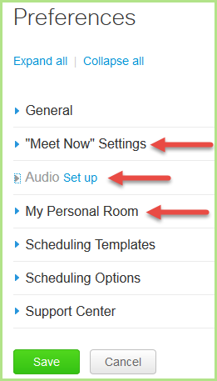
Profile and Preferences optimization
The My WebEx and My WebEx Profile sections have been optimized into the new sections:
Profile
Preferences
Preferences: General
Preferences: Meet Now
Preferences: Audio Settings
Preferences: Personal Room, Scheduling Templates, Scheduling Options, Support Center

Slide 11
Personal Room For Meeting Center
Cisco WebEx (Available upon request for direct net sites)

Slide 12
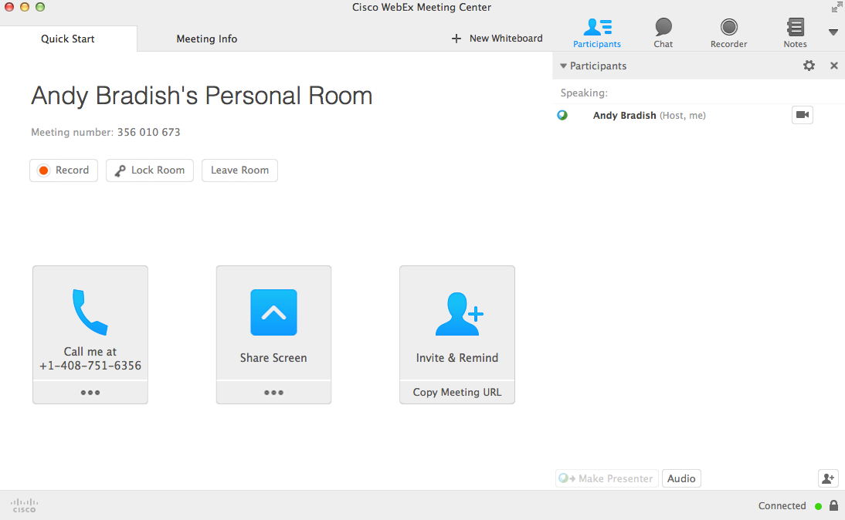
Personal Rooms (Meeting Center only)
Your own MC meeting with a vanity meeting link (link & meeting # do not change)
Example: cisco.webex.com/meet/jsmith
Personal Room may not be enabled on all sites. Can be enabled by the site administrator.
Dedicated Personal Room for Meeting Center
Permanent personalized video conferencing space
Your Personal Room provides an easy-to-remember destination for meetings.
Each WebEx Meeting Center host has a Personal Room
Vanity URL
Host lobby management (room lock)
Home Page Becomes Your Personal Room Page
Notification while sharing (you can select this message to view your entire lobby)
Link never changes (unless you want it to)
Host can manage attendees
Lock/unlock room much more prominent
Waiting attendees in the Lobby can be managed

Slide 13
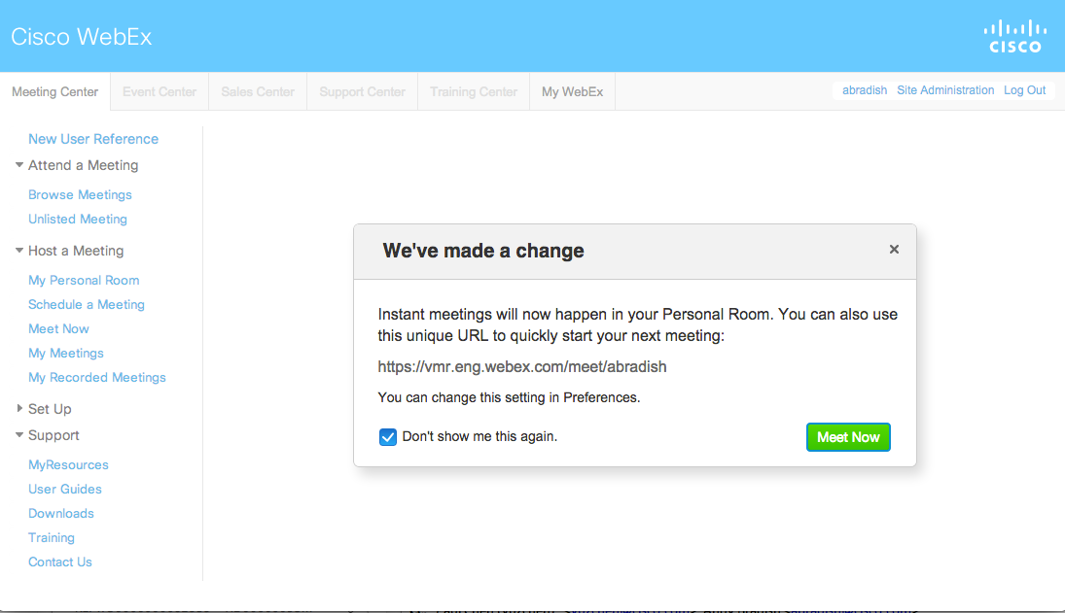
One-Click Meeting = Meet Now
One-Click Renamed to “Meet Now”
Launches your Personal Room by default
Pop up to let the user know “Meet Now” is in your Personal Room
Change back to the old dynamic link in Preferences

Slide 14
Site Administration updates
Existing Branding is preserved New HTML email templates for WebEx sites with Personal Room enabled
HTML and Plain Text
Email Templates – Revert to Default
Important: Email templates may revert to the default template as a result of the upgrade.
Deactivated Host Account -- when a host account is deactivated:
*Scheduled meetings or events for the deactivated user cannot be started
Alternate host cannot start the meeting or event
Schedule on behalf of deactivated host cannot be started
Message is displayed that the host is no longer active and Join button is disabled
No meeting or event reminders, no audio
Meeting Center - Browse meetings – Start button removed
Event Center – Register link is removed from List of Events
Event Center – Register link is removed
Training Center – Attendee view displays message that host has been deactivated and Join Now button is removed
Applies to Meeting Center, Event Center, and Training Center
Attendee Privileges – Print or Save Documents
Meeting Scheduler
Host can Disable or Enable the ability to print or save documents
When Enabled, if the host shares a document (not desktop), the attendee has the ability to save or print the document being shared
Sites that use XML API or LMS scheduling:
Check with API or LMS provider for compatibility.
May need to re-enter WebEx Partner ID
End users will need to download the new Meeting Center client and Productivity Tools (if applicable) etc.
The WebEx MSI files may need to be pushed to any users that do not have admin access to their PC.
Personal Meeting Room impacts the site email templates. Templates will revert to the default HTML template if Personal Meeting Room is enabled for the site.

Slide 15
Thank You!
Notes:
Slide Objective:
Set-up the expectations for the presentation today.
Tell them what you are going to tell them.

